Slide 1
Introduction to Machine Learning
Francesco Pugliese, PhD
francesco.pugliese@istat.it
Vamsi Guturi, Data Scientist
vamsivarmagunturi@gmail.com

Slide 2
We will discuss about…
What is Machine Learning ?
Traditional programming vs Machine Learning
A quick history of Machine learning
Types of Machine Learning
Machine learning terminologies
One traditional application ANN: Evolutionary robotics
DEEP LEARNING: Neural Networks become more effective

Slide 3
What is Machine Learning ?
Machine learning is a subfield of computer science that is concerned with building algorithms which, to be useful, rely on a collection of examples of some phenomenon.
The term Machine Learning was coined by Arthur Samuel in 1959, an American pioneer in the field of computer gaming and artificial intelligence and stated that "it gives computers the ability to learn without being explicitly programmed".
Machine learning is a tool for turning information into knowledge. The hidden patterns and knowledge about a problem can be used to predict future events and perform all kinds of complex decision making.
Machine learning can also be defined as the process of solving a practical problem by
Gathering a dataset
Algorithmically building a statistical model based on that dataset.
That statistical model is assumed to be used somehow to solve the practical problem.

Slide 4
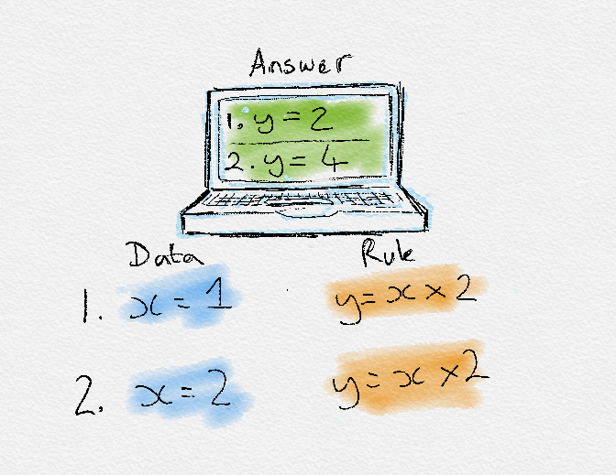
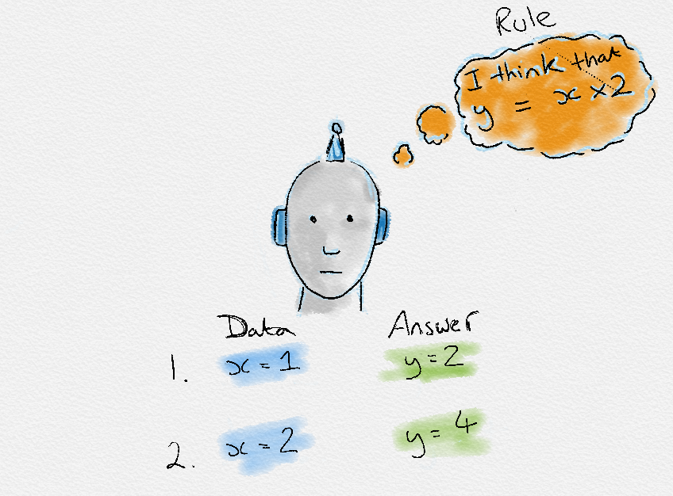
Traditional programming vs Machine Learning
Traditionally, software engineering combined human created rules with data to create answers to a problem. Instead, machine learning uses data and answers to discover the rules behind a problem.
To learn the rules governing a phenomenon, machines have to go through a learning process, trying different rules and learning from how well they perform. Hence, why it’s known as Machine Learning.
VS

Slide 5
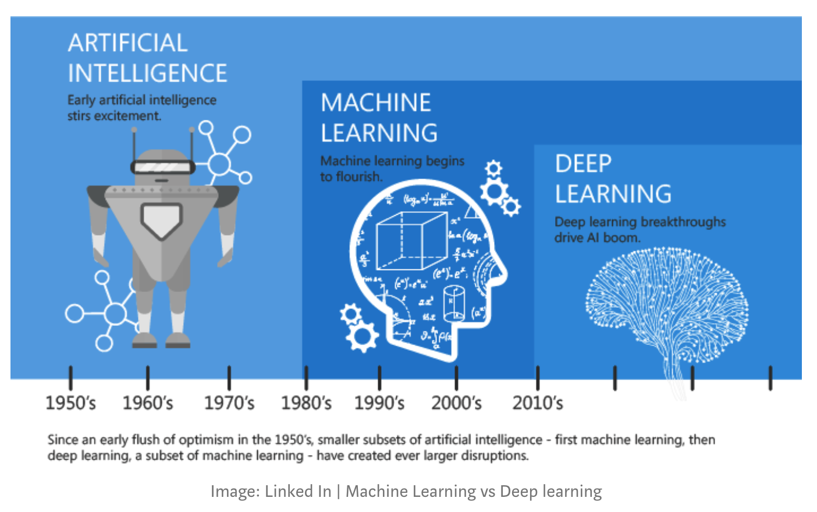
A quick history of Machine Learning

Slide 6
Types of Machine Learning
There are broadly 4 types of Machine Learning namely,
Supervised learning
Unsupervised learning
Semi-supervised learning
Reinforcement learning
Each form of Machine Learning has differing approaches, but they all follow the same underlying process and theory.
The No Free Lunch theorem is famous in Machine Learning. It states that there is no single algorithm that will work well for all tasks. Each task that you try to solve has it’s own idiosyncrasies. Therefore, there are lots of algorithms and approaches to suit each problems individual quirks.

Slide 7
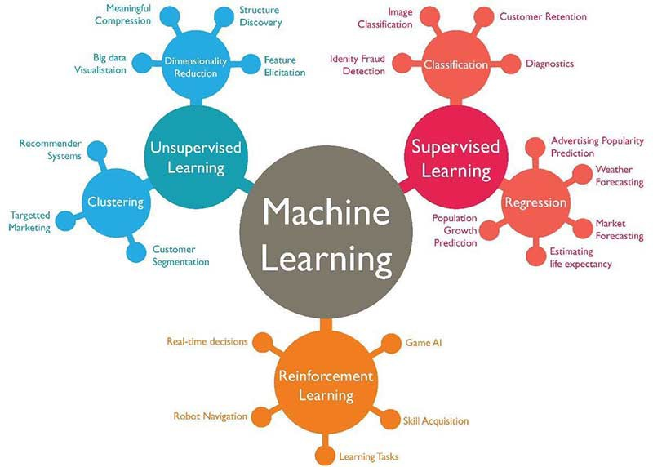
Types of Machine Learning

Slide 8
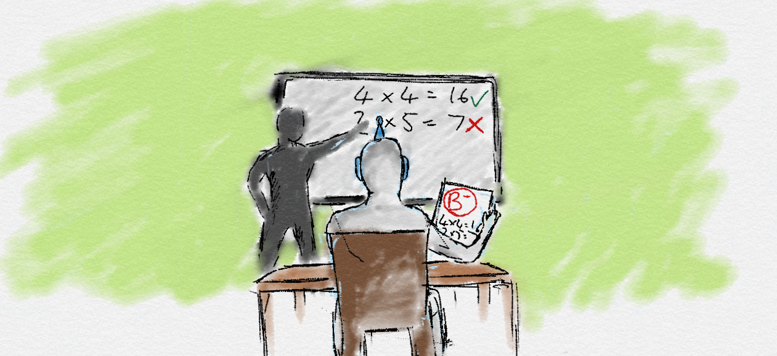
Supervised learning

Slide 9
Supervised learning
In supervised learning, the goal is to learn the mapping (the rules) between a set of inputs and outputs.
For example, the inputs could be the weather forecast, and the outputs would be the visitors to the beach.
The goal in supervised learning would be to learn the mapping that describes the relationship between temperature and number of beach visitors.
Example labelled data is provided of past input and output pairs during the learning process to teach the model how it should behave, hence, "supervised" learning.
For the beach example, new inputs can then be fed in of forecast temperature and the Machine learning algorithm will then output a future prediction for the number of visitors.

Slide 10
Supervised learning
Being able to adapt to new inputs and make predictions is the crucial generalisation part of machine learning. In training, we want to maximise generalisation, so the supervised model defines the real "general" underlying relationship.
If the model is over-trained, we cause over-fitting to the examples used and the model would be unable to adapt to new, previously unseen inputs.
A side effect to be aware of in supervised learning that the supervision we provide introduces bias to the learning. The model can only be imitating exactly what it was shown, so it is very important to show it reliable, unbiased examples.
Also, supervised learning usually requires a lot of data before it learns.
Obtaining enough reliably labelled data is often the hardest and most expensive part of using supervised learning. (Hence why data has been called the new oil!)

Slide 11
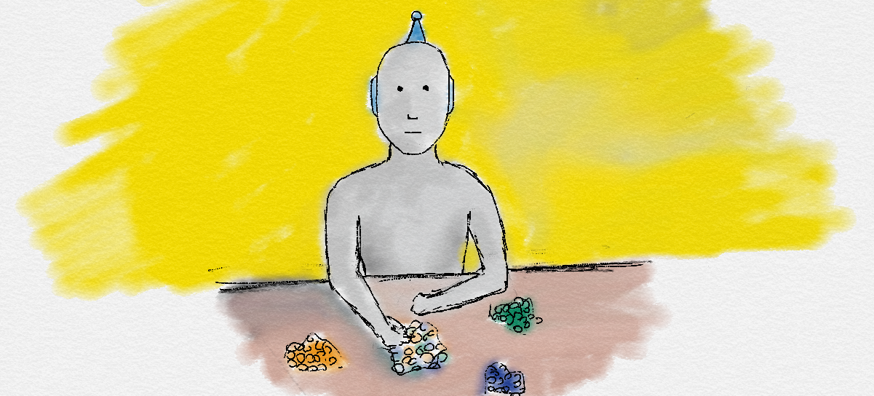
Unsupervised learning

Slide 12
Unsupervised learning
In unsupervised learning, only input data is provided in the examples. There are no labelled example outputs to aim for. But it may be surprising to know that it is still possible to find many interesting and complex patterns hidden within data without any labels.
An example of unsupervised learning in real life would be sorting different colour coins into separate piles. Nobody taught you how to separate them, but by just looking at their features such as colour, you can see which colour coins are associated and cluster them into their correct groups.
Unsupervised learning can be harder than supervised learning, as the removal of supervision means the problem has become less defined.
You start from a clean slate with less bias and may even find a new, better way solve a problem. Therefore, this is why unsupervised learning is also known as knowledge discovery. Unsupervised learning is very useful when conducting exploratory data analysis.

Slide 13
Techniques of Unsupervised learning
Some types of unsupervised learning are
Clustering
Density estimation
Dimensionality reduction
Latent variable models
Anomaly detection
More complex unsupervised techniques involve neural networks like Auto-encoders and Deep Belief Networks

Slide 14
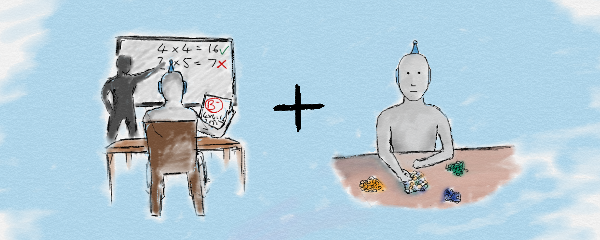
Semi-supervised learning

Slide 15
Semi-supervised learning
Semi-supervised learning is a mix between supervised and unsupervised approaches.
The learning process isn't closely supervised with example outputs for every single input, but we also don’t let the algorithm do its own thing and provide no form of feedback.
Semi-supervised learning takes the middle road. By being able to mix together a small amount of labelled data with a much larger unlabelled dataset it reduces the burden of having enough labelled data. Therefore, it opens up many more problems to be solved with machine learning.
Example: A perfect example is in medical scans, such as breast cancer scans. A trained expert is needed to label these which is time consuming and very expensive. Instead, an expert can label just a small set of breast cancer scans, and the semi-supervised algorithm would be able to leverage this small subset and apply it to a larger set of scans.

Slide 16
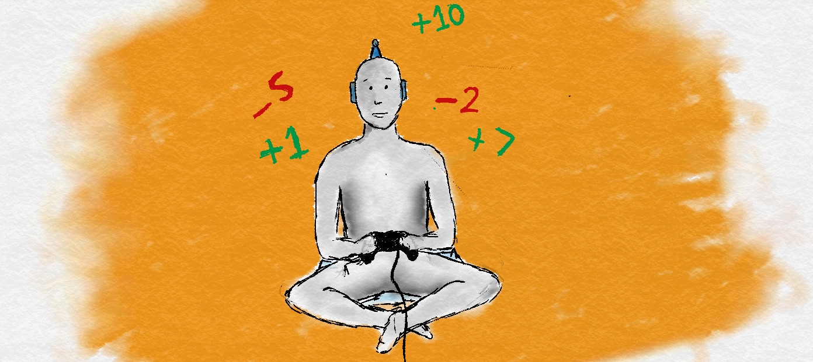
Reinforcement learning

Slide 17
Reinforcement learning
Reinforcement learning doesn't use labels as such, and instead uses rewards to learn.
If you're familiar with psychology, you'll have heard of reinforcement learning. If not, you'll already know the concept from how we learn in everyday life.
In this approach, occasional positive and negative feedback is used to reinforce behaviours.
Think of it like training a dog, good behaviours are rewarded with a treat and become more common. Bad behaviours are punished and become less common. This reward-motivated behaviour is key in reinforcement learning.
This is very similar to how we as humans also learn. Throughout our lives, we receive positive and negative signals and constantly learn from them. The chemicals in our brain are one of many ways we get these signals. When something good happens, the neurons in our brains provide a hit of positive neurotransmitters such as dopamine which makes us feel good and we become more likely to repeat that specific action.

Slide 18
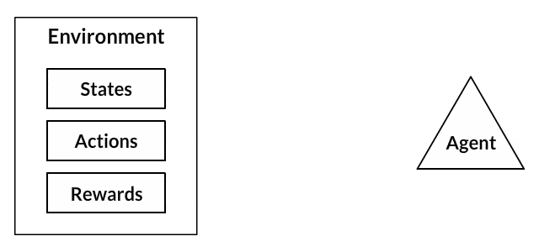
Reinforcement learning

Slide 19
Reinforcement learning
We don't need constant supervision to learn like in supervised learning. By only giving the occasional reinforcement signals, we still learn very effectively.
One of the most exciting parts of Reinforcement Learning is that is a first step away from training on static datasets, and instead of being able to use dynamic, noisy data-rich environments. This brings Machine Learning closer to a learning style used by humans. The world is simply our noisy, complex data-rich environment.
Games are very popular in Reinforcement Learning research. They provide ideal data-rich environments. A Reinforcement Learning algorithm just aims to maximise its rewards by playing the game over and over again.
If you can frame a problem with a frequent 'score' as a reward, it is likely to be suited to Reinforcement Learning.

Slide 20
Shallow vs Deep learning
A shallow learning algorithm learns the parameters of the model directly from the features of the training examples.
Most supervised learning algorithms are shallow.
The notorious exceptions are neural network learning algorithms, specifically those that build neural networks with more than one layer between input and output.
Such neural networks are called deep neural networks.
In deep neural network learning (or, simply, deep learning), contrary to shallow learning, most model parameters are learned not directly from the features of the training examples, but from the outputs of the preceding layers.
More details about this when we talk about deep learning…

Slide 21
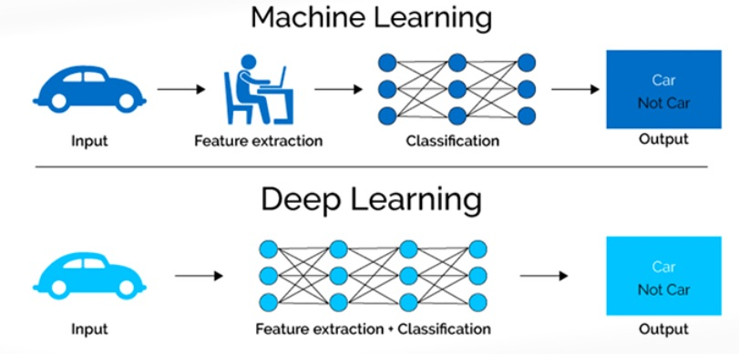
Deep Learning is Machine Learning
Deep Learning refers to algorithms that automatically ‘model’ high-level abstractions in data
here ‘model’ means: define, find, recognize and exploit
here ‘automatically’ means: directly from data, without hinging upon handcrafted, task-specific features.

Slide 22
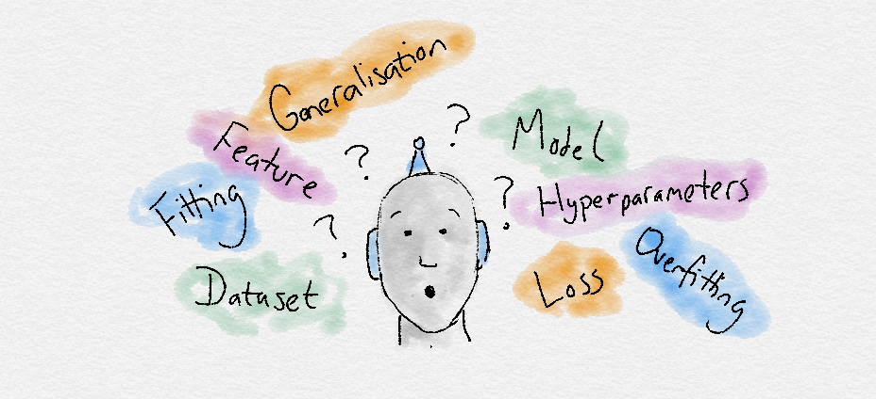
Machine Learning terminologies

Slide 23
Machine Learning terminologies
Dataset: A set of data examples, that contain features important to solving the problem.
Features:
Important pieces of data that help us understand a problem.
These are fed in to a Machine Learning algorithm to help it learn.
Model:
The representation (internal model) of a phenomenon that a Machine Learning algorithm has learnt. It learns this from the data it is shown during training.
The model is the output you get after training an algorithm.
For example, a decision tree algorithm would be trained and produce a decision tree model.

Slide 24
Parameter vs Hyperparameters
A hyperparameter is a property of a learning algorithm, usually (but not always) having a numerical value. That value influences the way the algorithm works.
Hyperparameters aren't learned by the algorithm itself from data. They have to be set by the data analyst before running the algorithm. More details when we discuss how we tune Machine learning models in the next sections.
Parameters are variables that define the model learned by the learning algorithm.
Parameters are directly modified by the learning algorithm based on the training data.
The goal of learning is to find such values of parameters that make the model optimal in a certain sense.

Slide 25
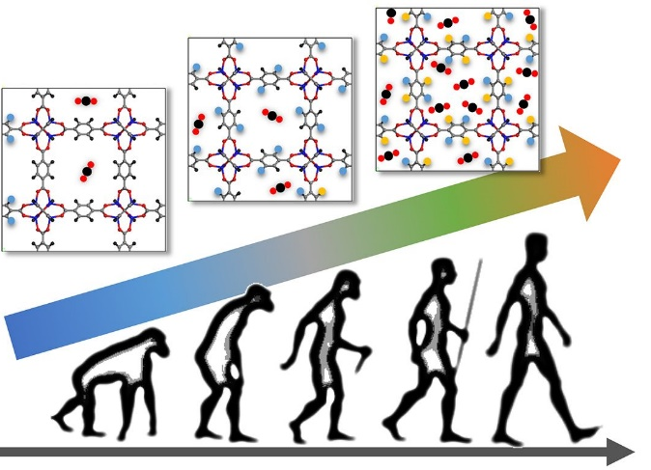
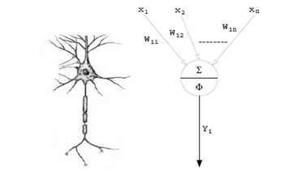
One traditional application ANN: Evolutionary robotics
In order to overcome the problems associated with the robotic system decomposition of traditional approaches (i.e. behavior-based robotics), evolutionary robotics can be used, where the robotic system is able to self-organize
[Nolfi, S., Floreano, D ., 2000].
NeuroGenetic Algorithm
Control Neural Network

Slide 26
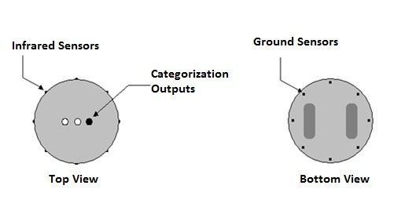
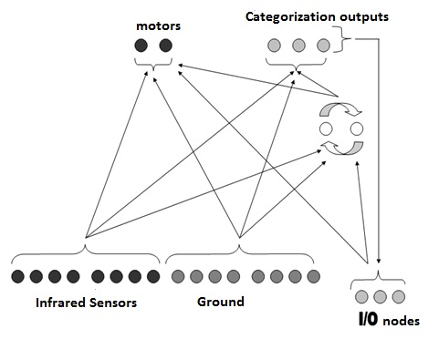

EXPERIMENTAL SETUP
ROBOT’S CHASSIS
NEURAL NETWORK
LEAKY Activation
$A_{j}=t_{j}+\sum{w_{ij}O_{i}}$ , $O_{j}=δ_{j}O^{t−1}+\left(1−δ_{j}\right)\left(1+\frac{1}{e^{A_{j}}}\right), 0≤δ_{j}≤1$

Slide 27
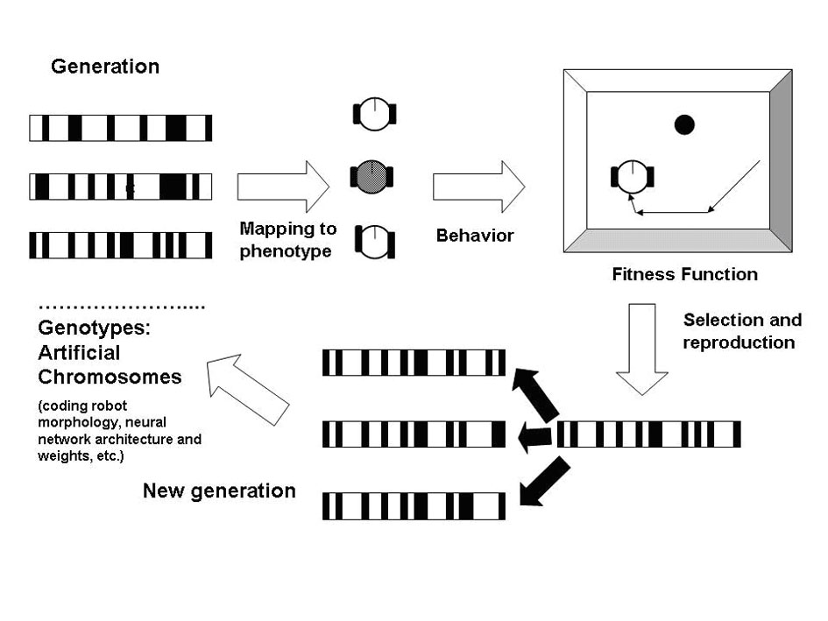
Evolutionary Robotics

Slide 28
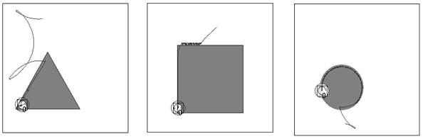
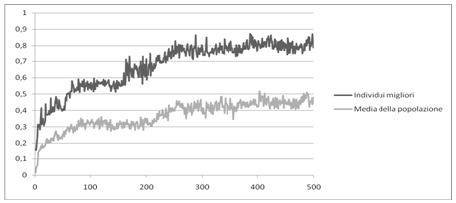
EXPERIMENTAL SETUP N.1
RESULTS
FITNESS CURVE

Slide 29
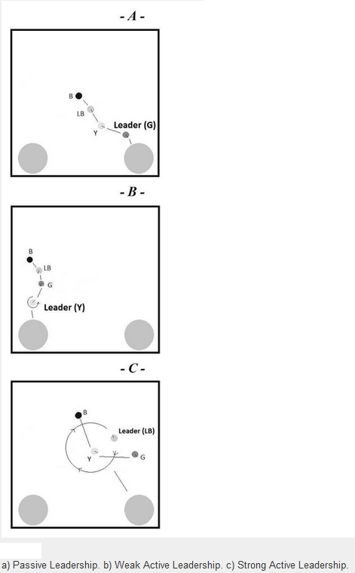
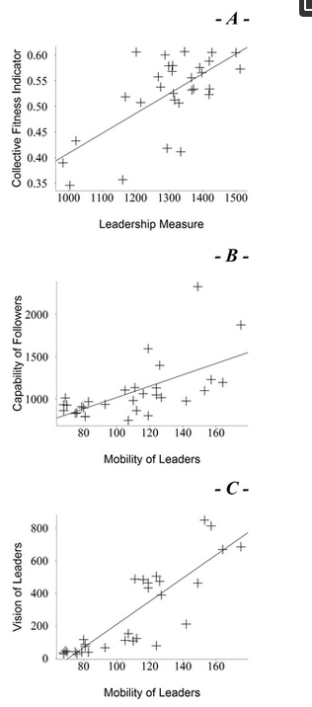
Emergence of Leadership in Robots
Behavioural and quantitative analysis indicate that a form of leadership emerges
Groups with a leader are more effective than groups without.
The most skilled individuals in a group tend to be the leaders.
Further analysis reveals the emergence of different “styles” of leadership (active and passive).
- A - Passive Leadership. - B - Weak Active Leadership.
C - Strong Active Leadership.
(Pugliese, et. Al., 2015)

Slide 30
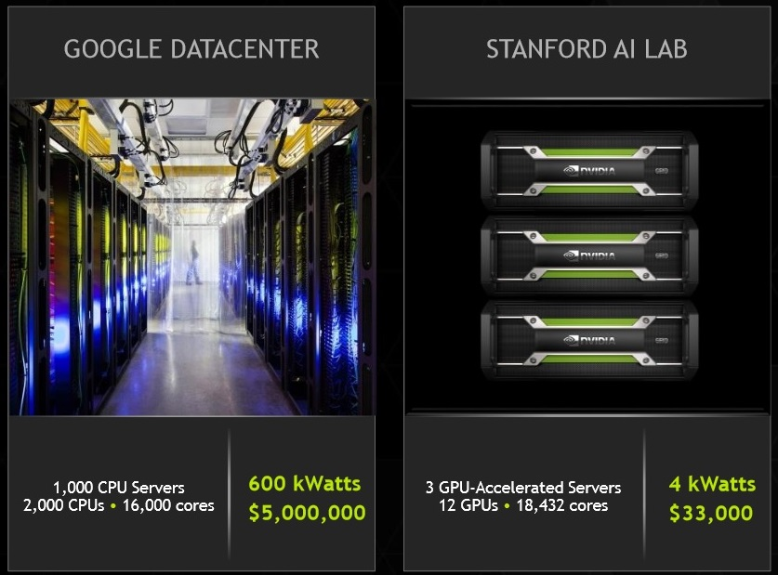
DEEP LEARNING: Neural Networks become more effective
In recent years Deep Neural Networks have achieved noticeably breakthroughs in research (Bengio, 2009). This new methodology dealing with deep neural networks and their training algorithms is called “Deep Learning”. So far, in all the experiments, the resulting performances were many magnitudes better than other machine learning techniques available.
GOOGLE DATACENTER
STANFORD AI LAB

Slide 31
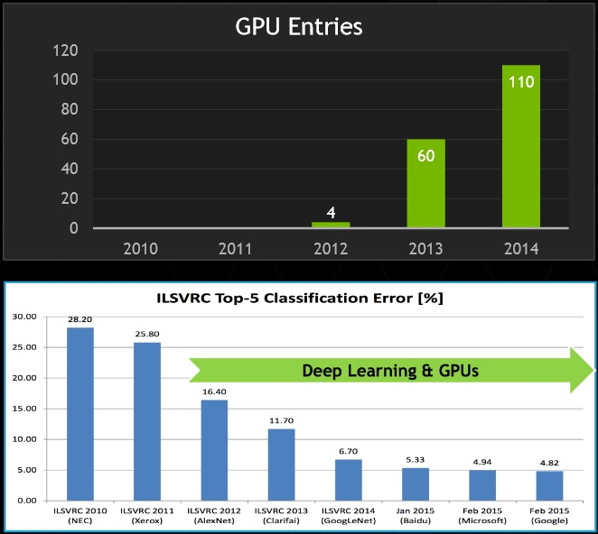
DEEP LEARNING: a cutting-edge approach to Computer Vision and NLP
GPU
The advent of GPUs makes possible the training of very large neural networks with even more than 150 millions of parameters.
BIG
DATA
A new generation of larger training and test sets.
DROPOUT
Better model regularization techniques have been discovered such as “Dropout” or “Data Augmentation”

Slide 32
References
Nolfi, S., Floreano, D., & Floreano, D. D. (2000). Evolutionary robotics: The biology, intelligence, and technology of self-organizing machines. MIT press.
Pugliese, F., Acerbi, A., & Marocco, D. (2015). Emergence of leadership in a group of autonomous robots. PloS one, 10(9), e0137234.
Bengio, Y. (2009). Learning deep architectures for AI. Foundations and trends® in Machine Learning, 2(1), 1-127.

Slide 33
Francesco Pugliese
Vamsi Gunturi
Sede Roma: Via Adriano Olivetti, 24 Tel: 06 43269281
Uffici Milano: Via Copernico, 38
Tel: 02 92852327
Reparto Marketing:
marketing@comedata.it
Reparto Commerciale:
sales@comedata.it
Social:
Facebook.com/comedata/@comedata | linkedin.com/company/comedata | yutube.com/user/Comedata

